Slide 1


Java ee
(ADVANCE JAVA)
Lecture-15

Slide 2
Today’s Agenda
Inter Servlet Communication
Transferring Request
Using Request Redirection
Using Request Dispatching
Using forward( ) and include( )

Slide 3
TRANSFERRING REQUEST
While developing a web app, it very often happens that we may want to transfer the user to any other web-resource
This web-resource may be a servlet, an HTML page available within our app or outside our app.
This is known as “TRANSFERRING REQUEST”.

Slide 4
TRANSFERRING REQUEST
Thus we can see that transferring request is an integral part of every web-application and in java it can be done in 2 ways:
Request Redirection
Request Dispatching

Slide 5
REQUEST REDIRECTION
Whenever in our servlet or jsp page we want to stop the current request processing cycle and move the user to any other resource then we use request redirection.
For ex:
After accepting userid/password from the user , our servlet may redirect the user back to the login page if the userid/password are incorrect

Slide 6
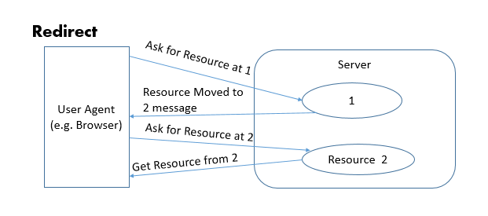
REDIRECT DIAGRAM

Slide 7
HOW TO PREFORM REQUEST REDIRECTION ?
For request redirection we use the method sendRedirect( ) of HttpServletResponse object.
When we call this method , the web server sends a special response code 302 /304to the browser redirecting it to another URL.
The prototype of the method is:
public void sendRedirect(String) throws IOException

Slide 8
HOW TO PREFORM REQUEST REDIRECTION ?
Example:
A. resp.sendRedirect(“login.html”);
B. resp.sendRedirect(“http://www.google.com”);
The first example will redirect the user to the page login.html and
the browser will assume that the page is present in the current
application. This is called relative addressing.
However the second example tells the browser to redirect to a
completely new location as it is giving complete url. This is called
absolute addressing

Slide 9
HOW TO PREFORM REQUEST REDIRECTION ?
There is another form of addressing available called only
addressing and we use it to redirect the user to another web-
resource under the same web server but in a different web
application.
For Example:
resp.sendRedirect(“/sachin/MyFirstServlet”);
The above statement would redirect the user to the servlet called
MyFirstServlet which is under a different web application called
sachin but on the same server.

Slide 10
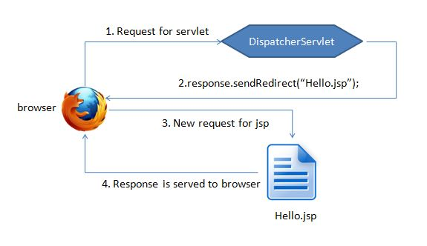
REDIRECT DIAGRAM

Slide 11
EXERCISE
Write a web application containing a servlet that redirects the user to the home page of the company whose browser the user is using.
That is , if the user is using chrome then he should be redirected to google’s home page , if he is using firefox then he should be redirected to Mozilla’s home page and if he is using Internet Explorer he should be redirected to Microsoft’s home page.

Slide 12
SOLUTION
import javax.servlet.*;
import javax.servlet.http.*;
import java.io.*;
public class RedirectServlet extends HttpServlet
{
public void doGet(HttpServletRequest req,HttpServletResponse resp)throwsServletException,IOException
{
String browser=req.getHeader("user-agent");
if(browser.indexOf("Chrome")!=-1)
resp.sendRedirect("http://www.google.com");
else if(browser.indexOf("Firefox")!=-1)
resp.sendRedirect("http://www.mozilla.com");
else
resp.sendRedirect("http://www.microsoft.com");
}
}

Slide 13
EXERCISE
Write a web application containing an HTML page and a servlet. The HTML page should ask the user to select the name of a website from facebook, twitter, google or youtube .
Then the servlet should be called which should redirect the user to the website he has selected

Slide 14
REQUEST DISPATCHING
In some cases in a web application we may want to include the content from an HTML page or the output of another servlet in the current servlet’s response which we have to send back to the client or we may want to pass the processing of the current Http-request to another servlet.
In such cases we use the technique called REQUEST DISPATCHING which is done using a special interface called RequestDispatcher

Slide 15
HOW TO PREFORM REQUEST DISPATCHING ?
Request Dispatching is done using the object of RequestDispatcher interface which is available in the package javax.servlet.
This has 2 methods which allow us to dispatch the request and they are:
include( )
forward( )

Slide 16
THE include( ) METHOD
public void include(ServletRequest req , ServletResponse resp) throws ServletException,IOException
As the name indicates , the method include( ) is used to add the contents of another web-resource (servlet, jsp or html page) into the current servlet’s reposnse.
So, the result which the browser then gets is the combined result generated from the output of 1st servlet as well as the web-resource which was called using include( )

Slide 17
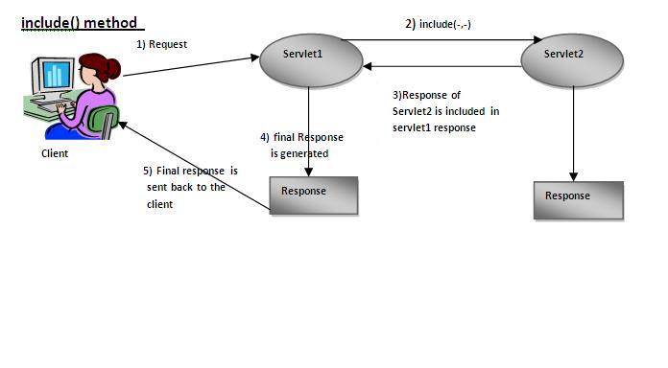
THE include( ) METHOD

Slide 18
THE forward( ) METHOD
public void forward(ServletRequest req , ServletResponse resp) throws ServletException, IOException
The method forward( ) is used to forward the current request from one servlet to another. The original servlet can perform some initial processing on the request and then forward it to another servlet/jsp for further processing.

Slide 19
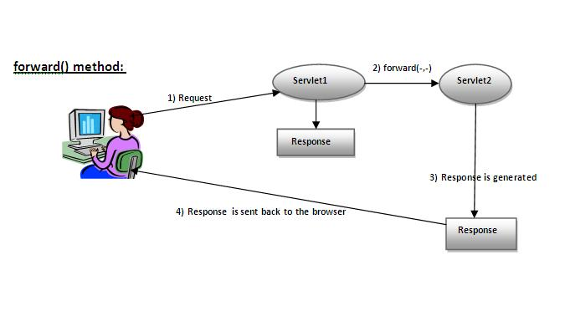
THE forward( ) METHOD

Slide 20
forward( ) vs include( )
Although both are methods of RequestDispatcher having the same prototype but they have a very important difference between them.
When we call include( ) from the 1st servlet then the control gets transferred to the 2nd servlet , collects the output generated by the 2nd servlet , comes back to the 1st servlet , if some extra result needs to be append ed to the response from 1st servlet then this activity is also done and finally the complete response is returned back to the client.
So the final shot to the response is given by the 1st servlet

Slide 21
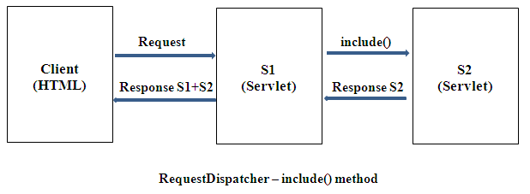
forward( ) vs include( )

Slide 22
forward( ) vs include( )
On the other hand when we call forward( ) then although the control comes back to the 1st servlet but till that time the response had already been committed to the client i.e. the 1st servlet never gets a chance to write something to the response.
Moreover if we have already committed the response then if we call forward( ) then we get an exception called IllegalStateException.
Thus forward( ) method should be used to give another resource the sole responsibility for replying to the user.

Slide 23
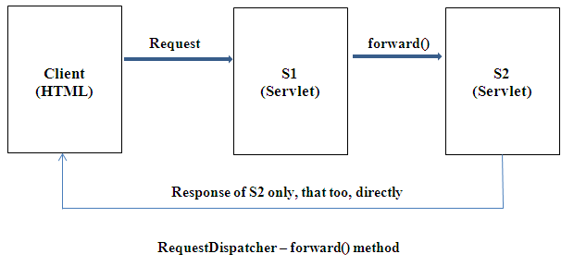
forward( ) vs include( )

Slide 24
STEPS REQUIRED FOR REQUEST DISPATCHING
Get an object of type RequestDispatcher
Using the RequestDispatcher object call the methods include() or forward() to dispatch request.

Slide 25
GETTING RequestDispatcher OBJECT
To get a RequestDispatcher object we have to call the method getRequestDispatcher( ) of HttpServletRequest object.
The prototype of the method is:
public RequestDispatcher getRequestDispatcher(String res)
The argument passed to this method is the name of the
resource to which we want to send the request.
For Example: If we want to send the request to
ServletTwo then
RequestDispatcher rd=req.getRequestDispatcher(“ServletTwo”);

Slide 26
CALLING METHODS OF RequestDispatcher OBJECT
Once we get the RequestDispatcher object we can call the methods include( ) or forward( ) passing them ServletRequest and ServletResponse objects
For Example:
rd.include(req,resp);
OR
rd.forward(req,resp);

Slide 27
PASSING DATA FROM ONE SERVLET TO ANOTHERCT
To pass data from one servlet to another servlet/jsp we can use the method setAttribute( ) of HttpServletRequest.
public void setAttribute(String key,Object value)
Similarly to retrieve data sent from the servlet to another servlet/jsp we can use the method getAttribute( ) of HttpServletRequest.
public Object getAttribute(String key)

Slide 28
PASSING DATA FROM ONE SERVLET TO ANOTHERCT
For Example:
In Servlet1
req.setAttribute(“currdate”,new java.util.Date());
In Servlet2
Date today=(Date)req.getAttribute(“currdate”);

Slide 29
EXERCISE
Write a web application containing the following 3 components:
An HTML page called home.html that prompts the user to enter 2 nos
A servlet called AddNosServlet which accepts these two nos , verifies the input and if either of the nos is incorrect( non numeric) or empty then it should transfer the request to the home.html page with an error message “Please input two integers”
Otherwise it should add the nos and send the result to DisplayResultServlet , which should display the nos and their sum

Slide 30
EXERCISE
Write a web application containing the following 3 components:
An HTML page that prompts the user to enter subject name for the book
A servlet which searches all the books related to the subject from the database
A servlet that displays the name and price of all the books searched by the previous servlet

Slide 31

End Of Lecture
For any queries mail us @: scalive4u@gmail.com
Call us @ : 0755-4271659, 7879165533
Agenda for Next Lecture:
Introduction To JSP
Servlet v/s JSP
Request Processing In JSP
JSP Tags

